Slide 1
Automated System for Image Processing using GUI
Professor. Walid Al-Atabany

Slide 2
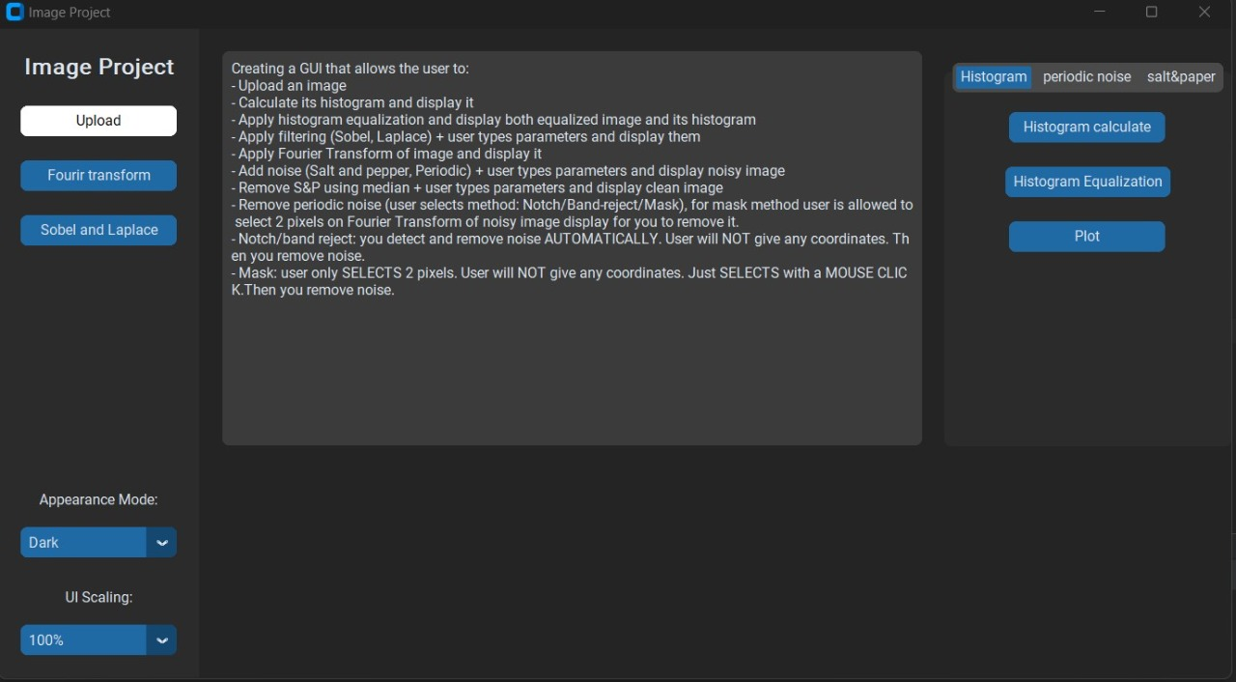
Interface of the Program

Slide 3
Problem
The majority of systems do not automate the image processing process
- Calculate its histogram and display it - Apply histogram equalization and display both equalized image and its histogram - Apply filtering (Sobel, Laplace) + user types parameters and display them - Apply Fourier Transform of image and display it - Add noise (Salt and pepper, Periodic) + user types parameters and display noisy image - Remove S&P using median + user types parameters and display clean image - Remove periodic noise (user selects method: Notch/Band-reject/Mask), for mask method user is allowed to select 2 pixels on Fourier Transform of noisy image display for you to remove it. - Notch/band reject: you detect and remove noise AUTOMATICALLY. User will NOT give any coordinates. Then you remove noise. - Mask: user only SELECTS 2 pixels. User will NOT give any coordinates. Just SELECTS with a MOUSE CLICK. Then you remove noise.

Slide 4
Apply Histogram

Slide 5
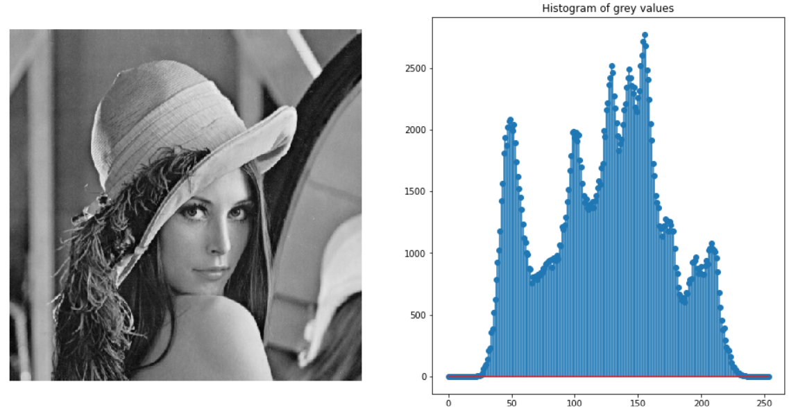
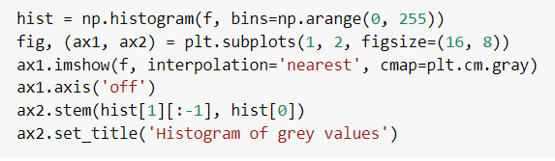
Apply Histogram

Slide 6
Calculate Histogram Equalization display it.
Linear Stretching
Piece-Wise Linear
Contract Adaptive histogram equalization (AHE)

Slide 7
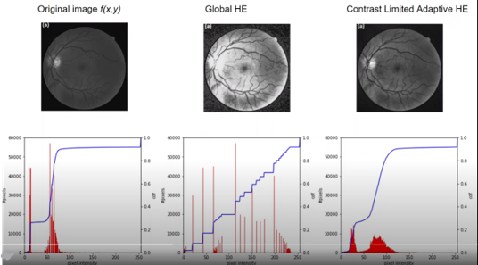
Histogram Equalization

Slide 8
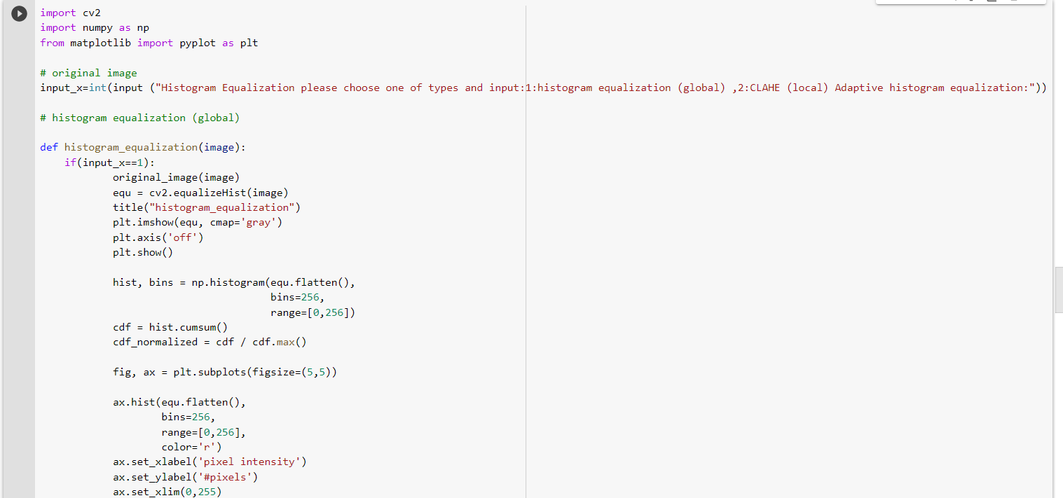
Sample of code to apply Histogram Equalization

Slide 9
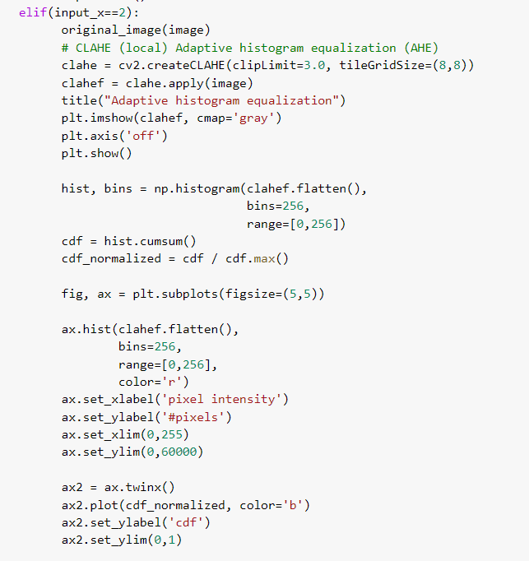
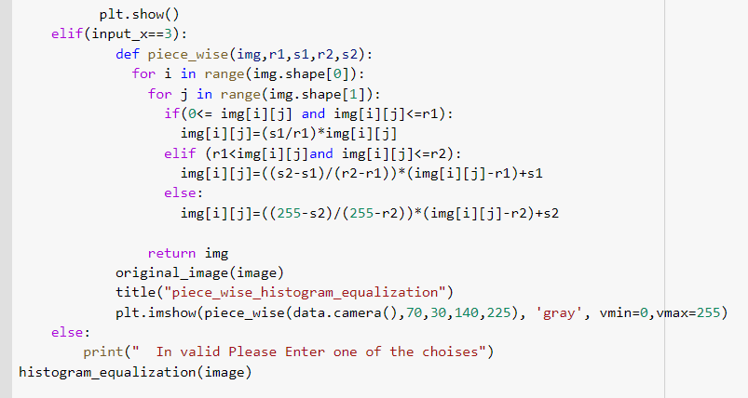

Slide 10
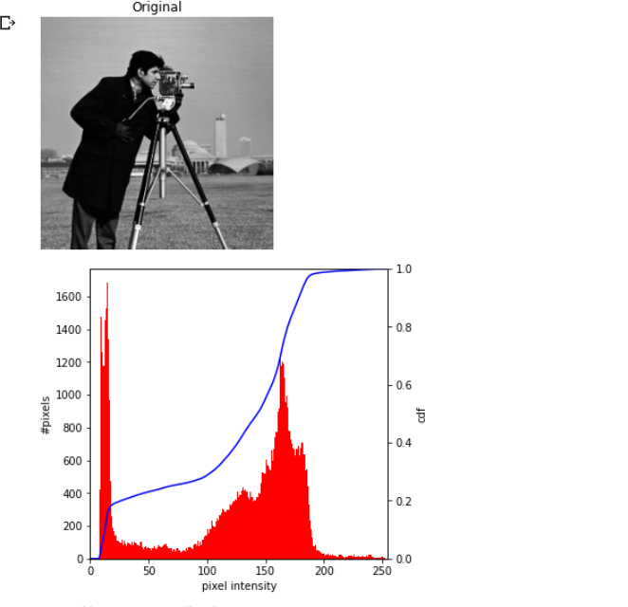
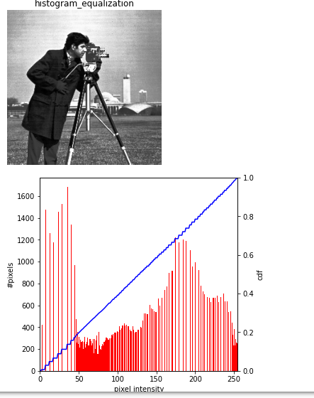
Result

Slide 11
Apply filtering (Sobel, Laplace)

Slide 12
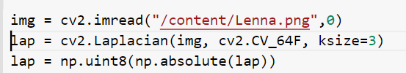

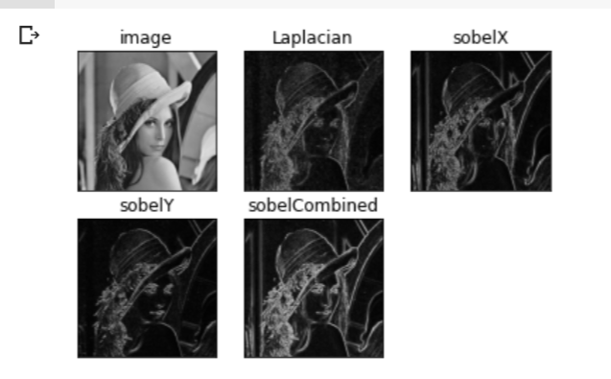
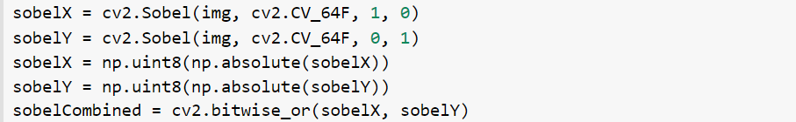
Apply filtering (Laplace, Sobel)
Laplacian Filter
2nd Derivative
Both X,Y
Sobel Filter
Sobel X
Sobel Y
Bitwise

Slide 13
Apply Fourier Transform of image and display it

Slide 14
Apply Fourier Transform of image and display it
Fourier Transform
2Types of Fourier Transform
First one apply as a filter
Second one apply as edge detection

Slide 15
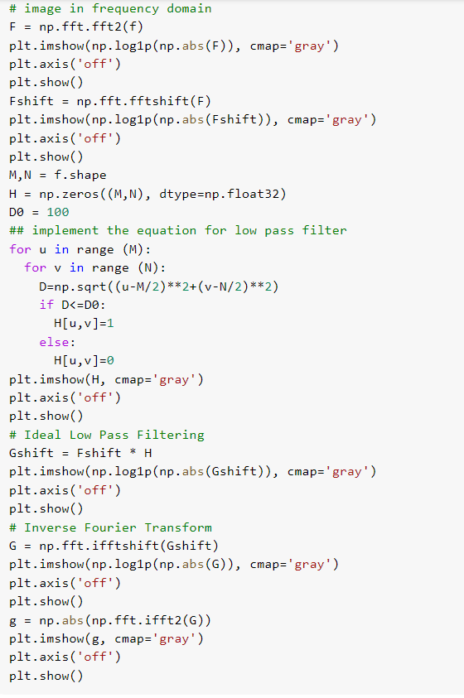
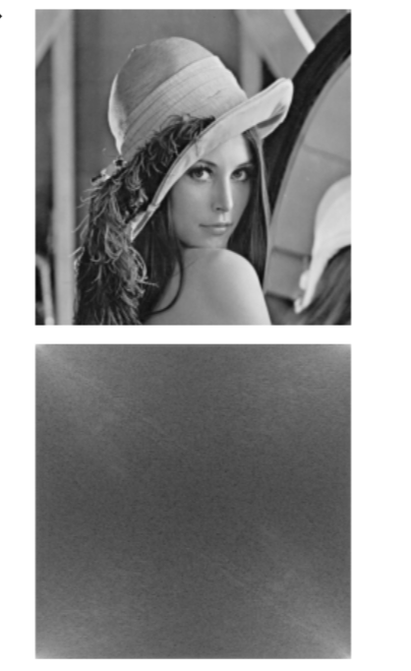
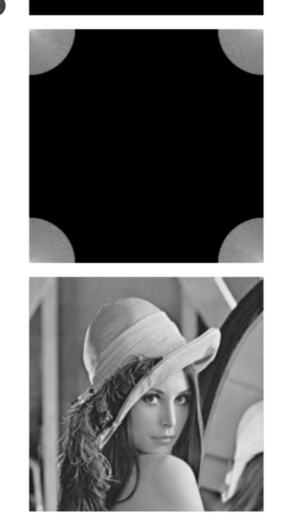

Slide 16
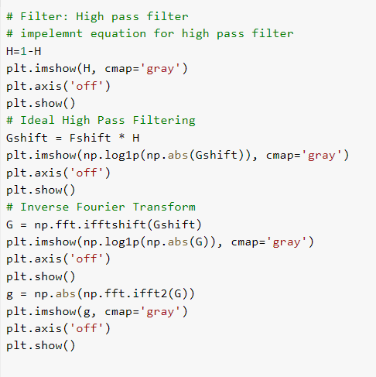
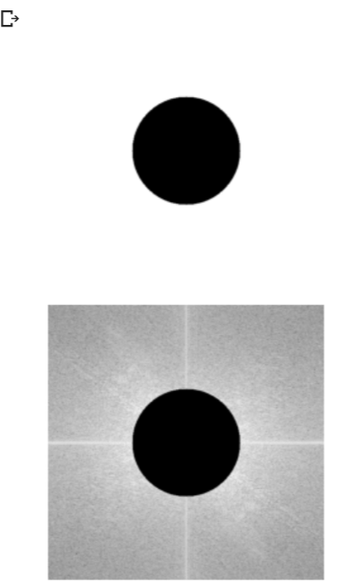
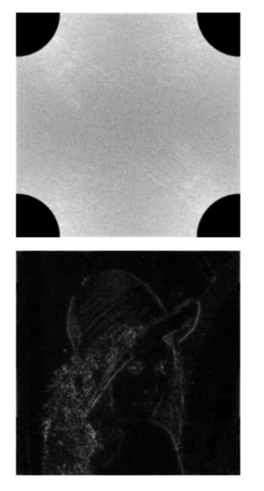

Slide 17
Add Salt and Pepper noise, Periodic noise

Slide 18
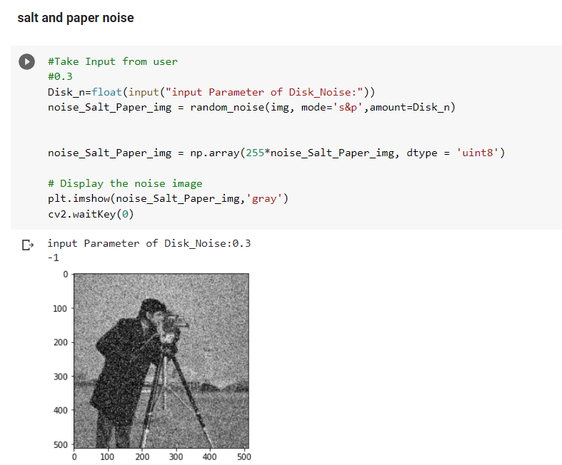
Add Salt and Pepper noise

Slide 19
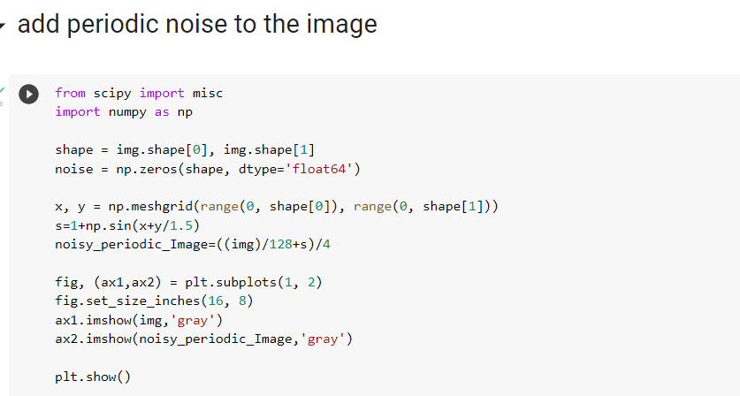
Add Periodic noise

Slide 20
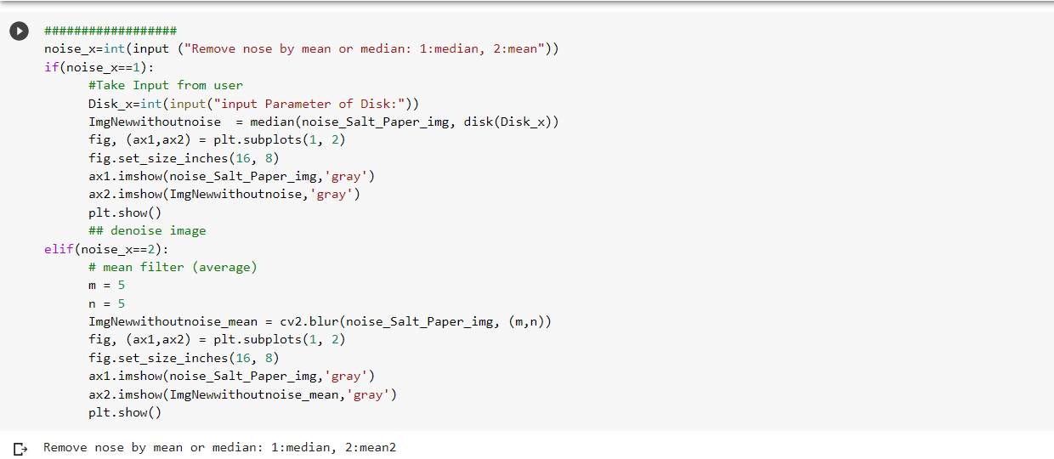
Remove Salt and Pepper using Median and Mean filters

Slide 21
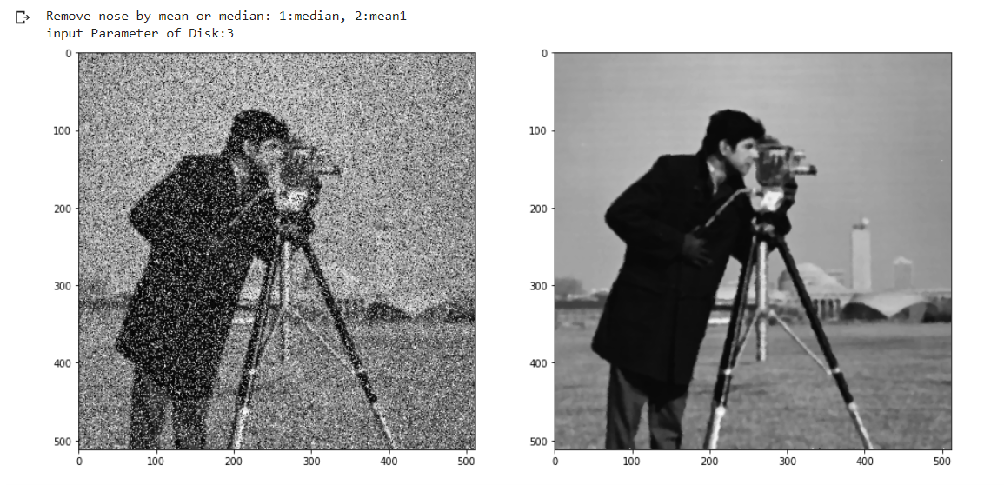
Result of the filters

Slide 22
Remove periodic noise Notch/band reject

Slide 23
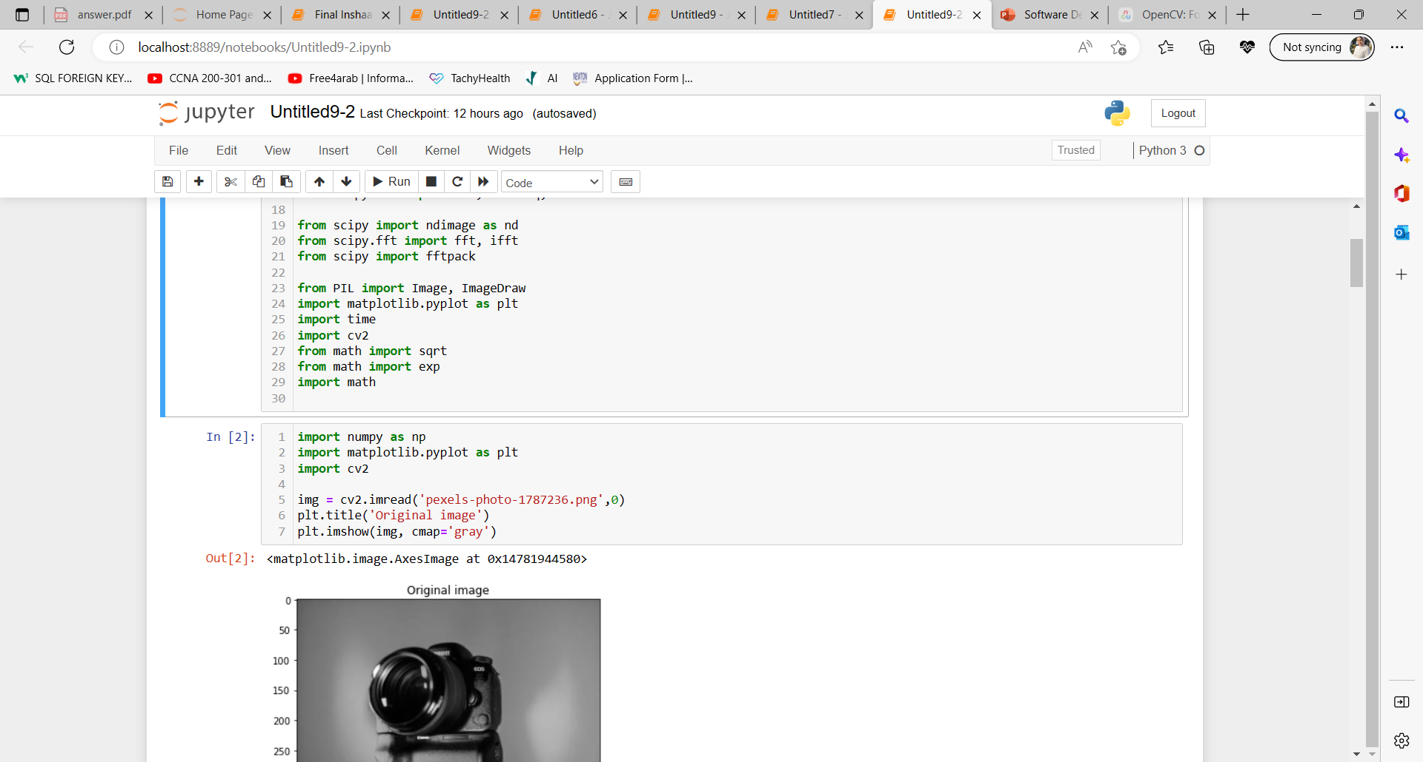
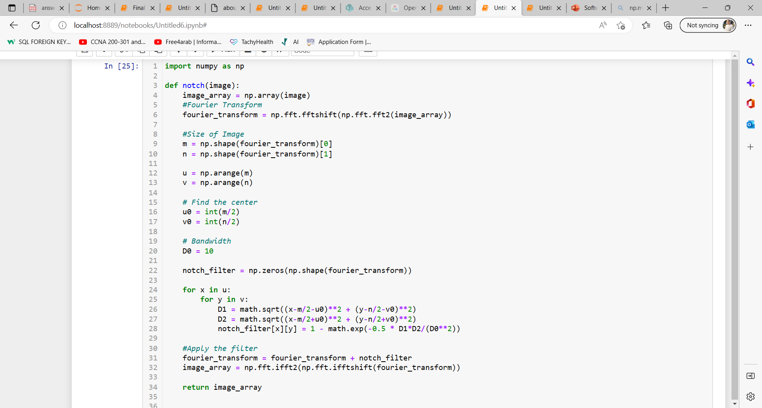
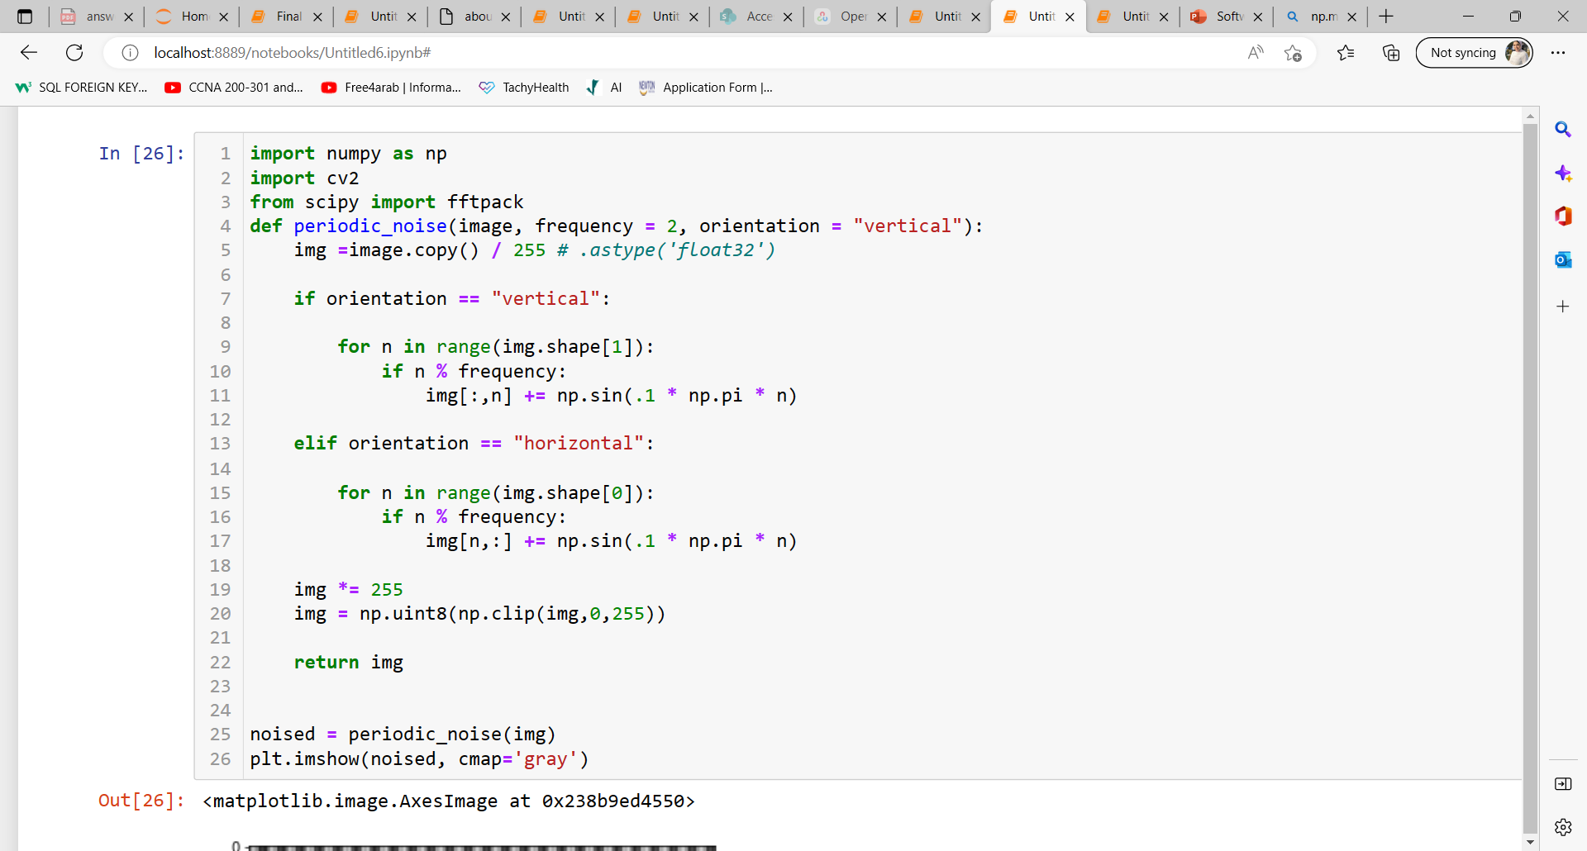
Remove periodic noise Notch/band reject: you detect and remove noise AUTOMATICALLY.
First, we will read the photo in the grey scale
3. apply notch filter: through DFT. Detection of the low-frequency region, detection of noise peaks and areas, and check the center for the high frequency. Loop on all pixels in the image then apply FT with notch on the image.
2. second, we will apply periodic noise vertically through detect periodic pattern in the spatial domain and apply the periodic noise horizontal

Slide 24
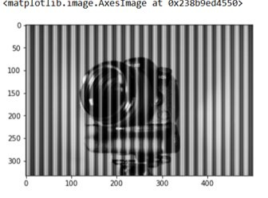
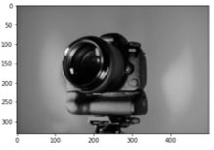
2. photo after removing noise by notch filter:
Photo after adding noise:

Slide 25
Remove Periodic Noise by mask on selected 2 pixels

Slide 26
Remove Periodic Noise by mask on selected 2 pixels
Read the photo in the grey scale
Get the Magnitude Spectrum of the image, then select 2 pixels on it.
Make these selected pixels with zero.
Conver Magnitude Spectrum to the real image by Inverse Fourier Transform.

Slide 27
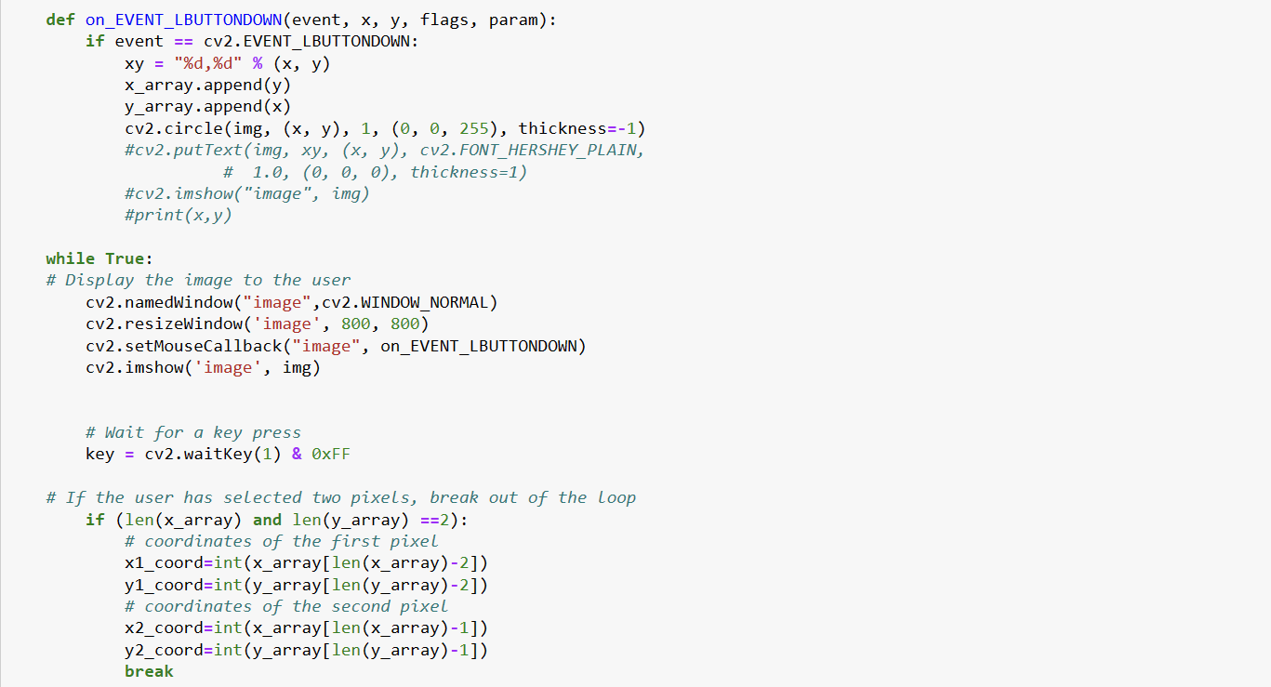
Remove Periodic Noise by mask on selected 2 pixels

Slide 28
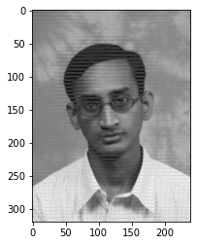
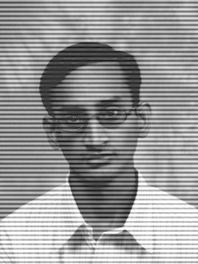
Result of removing Periodic Noise by mask on selected 2 pixels
Before
After

Slide 29
Demo

Slide 30

THANKS!

Slide 31
Team
Ahmed Hesham
Salma Ayman
Rawan Ramdan
Nadein Nassif
Habiba Mohamed

